Slide 1
Session 4
Future challenges

Slide 2
Nick Pahl
CEO SOM
nick.pahl@som.org.uk

Slide 3
Prevention and management of work-related ill health, occupational diseases and injuries and the protection of health of people at work;
The relief of those in need due to ill-health, disease, injury or disability by supporting them to keep in work or assist them to get into work
Advancing education, including the promotion and stimulation of research in the field of occupational health and medicine and related environmental issues, in particular by the publication of such research and the provision of guidance and advice on occupational health and medicine and environmental health issues
Including by forming for the above purposes a group of medical, nursing and allied health professionals interested in the practice of occupational health/medicine.
50 years since the health and safety at work act
Recently been an increase in people off work due to ill health
How can we support workers more?

Slide 4
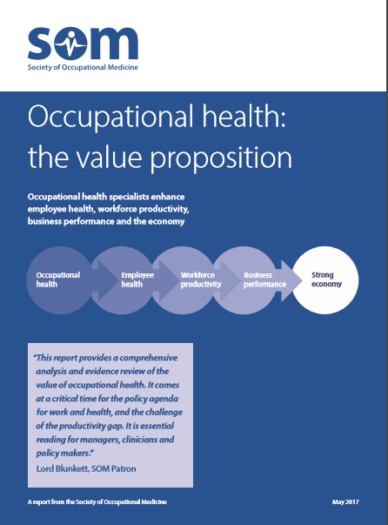
Nicholson PJ. Occupational health: the value proposition. Society of Occupational Medicine. London. 2017.
https://www.som.org.uk/sites/som.org.uk/files/Occupational%20health%20-%20the%20value%20proposition.pdf
A report based on 146 references:
50 systematic reviews and meta-analyses
37 studies
17 research reports
42 other publications

Slide 5
Adopt a systematic approach to managing wellbeing in the workplace, based on ill health prevention and managing the main risks to workers’ health
Develop effective working relationships, with mutual trust and credibility at its core
Recognise the boundaries of competence in relation to mental health and wellbeing, and work to increase the resource available to manage workforce mental health and wellbeing..
Increase influence within work, to advocate and encourage input into mental health and wellbeing strategy and initiatives across the primary, secondary, and tertiary level
Notes:
Adopt a systematic approach to managing mental health and wellbeing in the workplace, based on ill health prevention and managing the main risks to workers’ health. This means recognising that ‘good work’ is good for health, and that organisational decisions, processes, activities, and policies impact on the working experience of individuals, and in turn their mental health and wellbeing.
Develop effective working relationships, with mutual trust and credibility at its core. There also needs to be a clear understanding of where the respective roles and responsibilities of HR and OH for health and wellbeing stop and start, as well as other groups in the organisation, particularly leaders and managers.
Recognise the boundaries of their competence in relation to mental health and wellbeing, and to work to increase the resource available to manage workforce mental health and wellbeing. This could be in the form of personal development, improving capacity within the organisation, or developing appropriate external support. As part of this, to not only recognise the value of OH but to support and champion access to this service within their organisations.
Increase the influence within their work practices, to advocate and encourage their potential to input into mental health and wellbeing strategy and initiatives across the primary, secondary, and tertiary level.

Slide 6
What can you do as an organisation?
1. What are we looking to address?
2. What are the factors that contributed to this?
3. Can we address these underlying factors?
4. Can we better support our workers with what they do?
5. What is the evidence for the interventions being offered?
6. Who has the expertise to support us with this?
7. How do we know this has or will work?

Slide 7
Prevention and management of work-related ill health, occupational diseases and injuries and the protection of health of people at work;
The relief of those in need due to ill-health, disease, injury or disability by supporting them to keep in work or assist them to get into work
Advancing education, including the promotion and stimulation of research in the field of occupational health and medicine and related environmental issues, in particular by the publication of such research and the provision of guidance and advice on occupational health and medicine and environmental health issues
Including by forming for the above purposes a group of medical, nursing and allied health professionals interested in the practice of occupational health/medicine.
What should you expect from a good OH provider?
Focus on prevention
A strategic, data led approach
Wish to engage with the workforce and attend site in person

Slide 8
Prevention and management of work-related ill health, occupational diseases and injuries and the protection of health of people at work;
The relief of those in need due to ill-health, disease, injury or disability by supporting them to keep in work or assist them to get into work
Advancing education, including the promotion and stimulation of research in the field of occupational health and medicine and related environmental issues, in particular by the publication of such research and the provision of guidance and advice on occupational health and medicine and environmental health issues
Including by forming for the above purposes a group of medical, nursing and allied health professionals interested in the practice of occupational health/medicine.
How do you find a good OH provider?
Find a provider on the SOM website
Look for accreditations
Use the SOM commissioning guide at: https://www.som.org.uk/sites/som.org.uk/files/Suggested_steps_commissioning_OH_service_0.pdf

Slide 9
SOM is developing a buyer's guide for wellbeing products and services as part of a commitment to promoting evidence-based practice.
With the increasing number of providers and the wide-ranging approaches to wellbeing, it can be challenging to choose wellbeing solutions
Question and discussion session coming up!..

Slide 10
1 What health and wellbeing services have you bought recently or are looking to buy?
Digital / app-based products e.g for mental health and wellbeing
Health promotion activities e.g. fitness programmes/healthy eating initiatives
Health surveillance / Health screening
Case management services
Occupational health
EAP services
Wellbeing/ Stress awareness training
Psychosocial/ stress risk assessments
Data monitoring platform
Wellbeing survey

Slide 11
Prevention and management of work-related ill health, occupational diseases and injuries and the protection of health of people at work;
The relief of those in need due to ill-health, disease, injury or disability by supporting them to keep in work or assist them to get into work
Advancing education, including the promotion and stimulation of research in the field of occupational health and medicine and reated environmental issues, in particular by the publication of such research and the provision of guidance and advice on occupational health and medicine and environmental health issues
Including by forming for the above purposes a group of medical, nursing and allied health professionals interested in the practice of occupational health/medicine.
2 Who within your organisation is primarily responsible for approving the purchase of wellbeing products or services?
Occupational Health
Human Resources
Finance
Executive
Other?

Slide 12
3 What information is used to make buying decisions?
Existing data e.g. absence or employee survey data
Staff consultation
Mapping of needs against established frameworks
Knowledge gained (e.g. through research, conferences, LinkedIn)
Employee complaints
Legislative/audit recommendations
The company’s own data? If so, what?
Other?

Slide 13
How important are the following in your decisions to buy wellbeing services?
Evidence-base
Potential return on investment
Credibility/ authority and experience of the person/ company delivery the service
Experience in sector
Recommendation/reputation
Ease of purchase
Price
Adaptability/ tailoring of the content to our organisations needs
Level of support provided
Convenient access to data to monitor usage
How the product/ service integrates with existing policies/ practices
Other?

Slide 14
Prevention and management of work-related ill health, occupational diseases and injuries and the protection of health of people at work;
The relief of those in need due to ill-health, disease, injury or disability by supporting them to keep in work or assist them to get into work
Advancing education, including the promotion and stimulation of research in the field of occupational health and medicine and related environmental issues, in particular by the publication of such research and the provision of guidance and advice on occupational health and medicine and environmental health issues
Including by forming for the above purposes a group of medical, nursing and allied health professionals interested in the practice of occupational health/medicine.
How does you measure the effectiveness and ROI of wellbeing programs?
Employee feedback on the quality of training/intervention/consultation collected immediately afterwards
Employee questionnaires (such as survey data) well after the training/intervention/consultation (e.g. 3 months, 6 months)
Absenteeism rates
Presenteeism rates
Employee retention rates
Health risk assessments
Utilisation/attendance rates in wellness activities
Cost savings related to healthcare expenses
Other ?

Slide 15
Prevention and management of work-related ill health, occupational diseases and injuries and the protection of health of people at work;
The relief of those in need due to ill-health, disease, injury or disability by supporting them to keep in work or assist them to get into work
Advancing education, including the promotion and stimulation of research in the field of occupational health and medicine and related environmental issues, in particular by the publication of such research and the provision of guidance and advice on occupational health and medicine and environmental health issues
Including by forming for the above purposes a group of medical, nursing and allied health professionals interested in the practice of occupational health/medicine.
What are the challenges you face when evaluating new wellbeing services?
Limited data availability
Lack of time for comprehensive assessment
Lack of designated responsibility or leadership for evaluation
Limited budget/resources for evaluation efforts
Limited awareness of the methods available for evaluating wellbeing programs/services
Difficulty in establishing metrics and benchmarks for assessing effectiveness
Resistance from employees towards participating in evaluation activities
Other?

Slide 16
2023 Budget recognition
PM announcement around fit notes

Slide 17
Prevention and management of work-related ill health, occupational diseases and injuries and the protection of health of people at work;
The relief of those in need due to ill-health, disease, injury or disability by supporting them to keep in work or assist them to get into work
Advancing education, including the promotion and stimulation of research in the field of occupational health and medicine and related environmental issues, in particular by the publication of such research and the provision of guidance and advice on occupational health and medicine and environmental health issues
Including by forming for the above purposes a group of medical, nursing and allied health professionals interested in the practice of occupational health/medicine.
OH Expert group for OH for SMEs
£25m for subsidy pilot for SME’s to access occupational health to examine the impact on uptake of OH and build an evidence base for a national roll out of the subsidy. 80% subsidy for first assessment in NW
Work Well - £57m for 15 pilots
Consultations:
Fit notes
PIP
Treasury response on incentives – response tbc

Slide 18
Prevention and management of work-related ill health, occupational diseases and injuries and the protection of health of people at work;
The relief of those in need due to ill-health, disease, injury or disability by supporting them to keep in work or assist them to get into work
Advancing education, including the promotion and stimulation of research in the field of occupational health and medicine and related environmental issues, in particular by the publication of such research and the provision of guidance and advice on occupational health and medicine and environmental health issues
Including by forming for the above purposes a group of medical, nursing and allied health professionals interested in the practice of occupational health/medicine.
Advocacy focus
Universal Access to OH, including enforcement using HSE
DWP/DHSC Work Well implementation
Fit note review

Slide 19
Prevention and management of work-related ill health, occupational diseases and injuries and the protection of health of people at work;
The relief of those in need due to ill-health, disease, injury or disability by supporting them to keep in work or assist them to get into work
Advancing education, including the promotion and stimulation of research in the field of occupational health and medicine and related environmental issues, in particular by the publication of such research and the provision of guidance and advice on occupational health and medicine and environmental health issues
Including by forming for the above purposes a group of medical, nursing and allied health professionals interested in the practice of occupational health/medicine.
Future OH delivery
Mixed market – NHS and commercial
Multidisciplinary
Bio psychosocial delivery, with OH “wrap around”
Use of online tools
Better outcome measures and quality indicators e.g. through SEQOHS
Innovation e.g. AI for Fit note
Job design and good work
..role of manager crucial – support / flexibility etc

Slide 20
Mon 17 Jun 4-5pm
Noise issues at work – Clare Forshaw
Tue 25 Jun 3-4pm
Onwards and upwards, the future for OH technicians A panel discussion on the role and contribution of OH Technicians, challenges and opportunities including education. – Panel discussion
Wed 10 Jul 12-1pm
Skin issues at work - Dr Katrin Alden
Mon 2 Sep 12-1pm
Hand Arm Vibration at work - Dr Ian Lawson
Mon 14 Oct 12-1pm
From Risk assessment to Health surveillance - a journey explained – Dr Dil Sen
Register at https://www.som.org.uk/events
SOM Webinars

Slide 22
Thanks!
ANY QUESTIONS?
You can find me at:
nick.pahl@som.org.uk
@somceo

Slide 23
Good Days at Work: Measurement as an integral part of health, safety and performance — Ben Moss, Managing Director, Robertson Cooper

Slide 24
Robertson Cooper
 | Founded over 20 years ago by Professor Sir Cary Cooper and Professor Ivan Robertson, who are globally recognised as being in the top 2% of influential psychologists.
 | We're a team of wellbeing specialists and business psychologists, passionate about creating Good Days at Work for everyone, everywhere.
 | We achieve this by helping businesses build health, safety and wellbeing capability, underpinned by clear strategies, measurement and performance-driven training solutions.
 | We take a holistic, evidence–based approach and are known for providing leading workplace wellbeing research.
Notes:
More on Good Days at work shortly
Research & thought leadership – some of which I’m going to talk about today

Slide 25
What does a Good Day at Work mean to you?
By increasing the average number of ‘Good Days at Work’ per week by just one day, research shows a:
13%↑ in productivity
17%↑ in job satisfaction
15%↓ in intention to leave
6↓ days of presenteeism
5↓ days of sickness absence per year
Robertson Cooper 2023
Good Day at Work
Positive experiences: they feel ‘excited’ and ‘motivated’
Social relationships: they have positive connections with their colleagues
Task achievement: they can ‘get their work done’
Meaningful work: the work they do makes an impact and has purpose
Notes:
Since then we have asked this question thousands and thousands of times…. And when we do almost every answer fits into one of these categories –
Positive experiences
Task achievement
Social relationships
Meaningful work
Take a moment to think of your own answer to the question… do your answers fit the categories?
Good Day at Work started as a tagline in marketing, but we realised it could be so much more if we applied our people science to it – we can measure it and relate to important business level outomes - run through impact areas for 1 extra good day per week, imagine that across the whole workforce
Our research shows that to create a culture of good days at work, where health and wellbeing is high, you need to focus on these 4 areas:
1. Positive experiences and energy – When people feel they’ve had a positive experience at work and that they’ve had high energy, they often feel they’ve had a good day. This also includes experiencing positive emotions such as: Confidence, curiosity, excitement and satisfaction.
2. Work relationships - When people develop a meaningful connection with their teams, leaders or managers, they’re much more likely to experience more Good Days at Work.
3. Achievements - It’s a myth that people want to laze around and not do any work. Almost everyone has a desire to achieve goals: from big goals to simply ticking off the tasks on their to-do list. We’ve had a Good Day at Work when we’re productive and can get through our tasks.
4. Meaningful work - When at least some of the tasks that people perform clearly and positively contribute to something bigger, then they’ll be heading for more Good Days at Work
******************************************************************
So what does this mean in practice?
Our research shows that by increasing GDAW by just 1 day can improve productivity, increase employees recommending you as a place to work, improve job satisfaction, reduce intention to leave, reduce presenteeism and Improve attendance.
It is important to note that you can't just focus on GDAW and hope that all of these will improve. While a focus on HSW can improve all of these outcomes its important to be clear which matter most to the business. The key is identifying from the outset what outcomes are important to you and ensuring that the program design and the subsequent actions that are implemented are tailored to support the desired goal.
The approach becomes even more innovative when organisations start to measure these over time. This is when they can start getting into predictives. This is something that is happening over at EDF at the moment. They have years’ worth of data with us and now we are working with their analysts on a data mapping exercise to look at predictive analytics.
We can start to ask the questions what behaviours may predict certain outcomes. What warnings or triggers might be occurring in the data that we collect that we could intervene early on perhaps to prevent someone from going off sick from work or regrettable turnover.
This can only happen when a long-term commitment to a data driven approach is put in place – this is over years rather than months. But this is what the best companies in this area are doing.

Slide 26
01 | Making sense of health & wellbeing data

Slide 27
Establishing the baseline
GOOD DAY AT WORK DATA COLLECTION
New data highlighting key drivers for wellbeing
MATURITY MATRIX
New data evaluating the current wellbeing initiatives
LEADERSHIP INSIGHTS
New data examining the impact of leadership
Showing balanced, challenge and support led styles
EXISTING DATA
Linking up of existing data with the new wellbeing data
HEALTH AND WELLBEING BASELINE
Study by Fleming (2024) 46,000 employees: workplace wellbeing initiatives do not improve mental health
Recommended focus on improving the work environment. We agree.
Notes:
We help clients to understand wellbeing through our Good Day at Work model - including supporting many organisations establish the baseline for wellbeing in their organisation. So often wellbeing is seen as an initiative, a benefit or a communications campaign.
You may have seen recent press coverage of a study by William Flemming at the University of Oxford's Wellbeing Research Centre - demonstrated that many wellbeing initiatives simply do not work. Generally, the failure lies in the lack of a strategic approach that truly addresses organisational health and wellbeing risks and opportunities.
We know through our research that by understanding the drivers of health and wellbeing (and Good Days at Work) in organisations, we can establish what levers organisations can pull to make improvements for the benefits of all.
But none of that can happen without a clear baseline as part of a strategic approach to wellbeing,
We believe there are 4 key areas that can enable organisations to develop a comprehensive understanding of wellbeing:
Collecting health and wellbeing data to track progress towards more good days at work - we use our Good Day at Work data collection (used with EDF NUCLEAR OPS AND NUCLEAR SERVICES who are here today – so they will tell you more about that process.
The maturity journey
Collating and dashboarding existing data alongside new data collection
Leadership style to support the desired goals
*Fleming, W. J. (2024). Employee well-being outcomes from individual-level mental health interventions: Cross-sectional evidence from the United Kingdom. Industrial Relations Journal, 55, 162–182. https://doi.org/10.1111/irj.12418

Slide 28
Employee Survey: Good Day at Work
Fully validated and normed question sets that measure current pressures, levels of health and wellbeing and performance:
Six Essentials - Drivers
Balanced workload
Health and wellbeing
Psychological health
Performance
Productivity
Job security and change
Job conditions
Resources and communication
Work relationships
Control
Physical health
Subjective wellbeing
Engagement
Resilience
Intention to leave
Advocacy
Absenteeism
Presenteeism
Energy
Good Days at Work
Notes:
Measurement approach is underpinned by an established and research-defined model where the question sets link together
Gives employers an understanding the drivers of health, safety and wellbeing and therefore insights into the levers available to address them –
This is a tried and tested risk assessment approach and aligns well with ISO 45001/03.
Geared to the idea of GDAW, not standard employee opinion survey – psychometrically designed, norm-based
The drivers you’ll recognise, but it’s the ability to perform predictive analysis because of the underpinning model that sets the approach – for example, which 2 things deliver more good days for your business?
Designed to deliver reliable , actionable insights and feedback

Slide 29
The Good Day at Work Maturity Matrix
Baselining the development of your business’ health, safety and wellbeing maturity across four dimensions:
Best Practice
Strategy: Mission, vision and values; purpose, goals and performance; agility
Work environment: Organisational structure; process, policy and procedure; resources
Social Environment: Leadership, collaboration, L&D, recognition and D&I
Health, safety & wellbeing: Awareness & promotion; physical and psychosocial risk management
Five Stages of Maturity:
5. Best Practice
4. Leading Practice
3. Good Practice
2. Inconsistent Practice
1. Poor Practice
Notes:
A practice audit that places the business at a stage of maturity & evaluates current practice against a detailed set of criteria to baseline the business.
You will be used to this concept in H&S – where it is a tried & tested approach – but much less common in Health and Wellbeing; this tool covers both
Review of existing data establishes how embedded and ‘cultural’ health, safety and wellbeing are within the organisation. Shows the distance to travel to reach the next - and indeed final destination - stage of maturity
Defines the environment that will lead to success
Defines and motivates leadership and employee behaviours that support health, safety, wellbeing and business performance.
From here, a plan for development is possible.

Slide 30
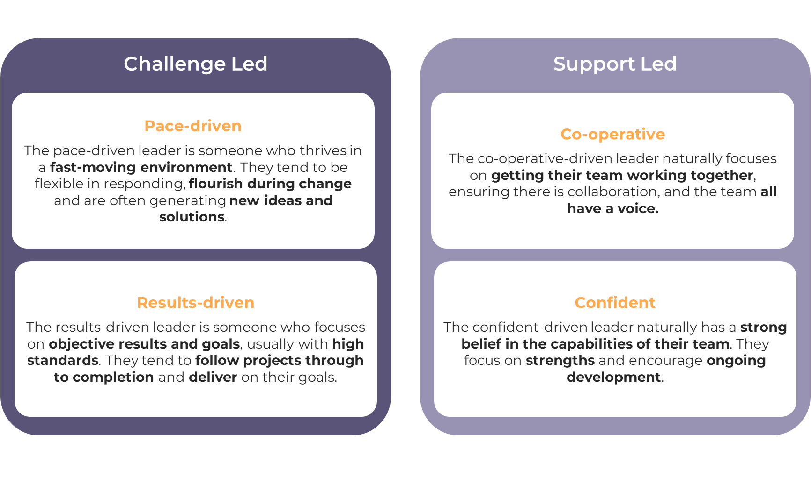
Leadership Impact on health and wellbeing culture
Notes:
We developed Leadership Impact - a Personality-based report that enables every leader to be mindful of their personal role in influencing pressure in their teams.
Enables Leaders and Managers to understand how their natural style impacts the health, safety and wellbeing of those in their team.
Enables managers to make links between their natural style and the health and wellbeing data for their own team.
Provides a view of whether leadership culture ‘around here’ is mainly Challenge or Support led - and enables discussion of the implications of that
Most importantly, leaders learn to flex their natural style in the name of wellbeing and performance

Slide 31
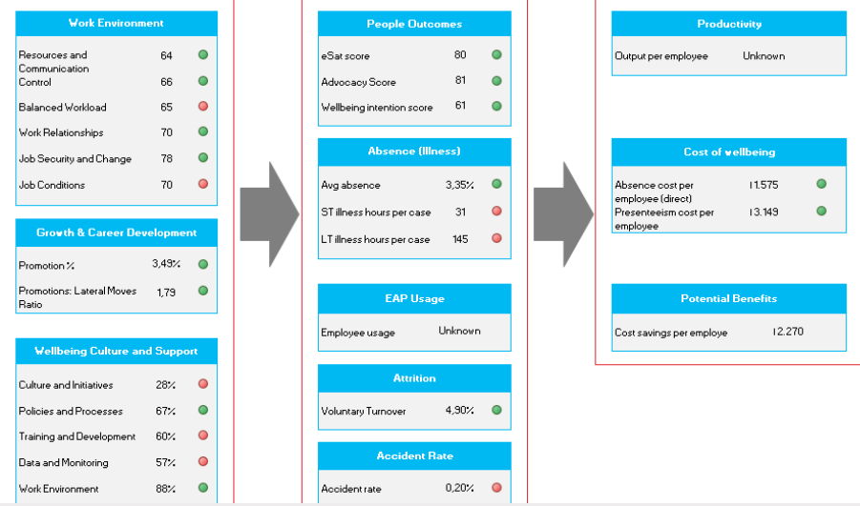
Data dashboard example: new and existing data
Health & Wellbeing Drivers
People Outcomes
Financial Impact
Notes:
Bringing it all together:
This is an example of the kind of dashboard we can create based on these multiple sources of information (including existing organisational data gathered as part of the maturity assessment)
This one shows how drivers flow to people outcomes and then financial impact – and enabled the client to take concrete decisions about where to focus resources and organisational development efforts

Slide 32
Good Day At Work case study
EDF UK take a combined data-driven and person-centred approach to inform health and wellbeing strategies
EDF Nuclear Operations and Nuclear Services are specifically using Good Day at Work (GDAW) to provide further evidence-based insights to inform their approach
Nuclear Operations have recently collected their 4th dataset and are at the stage where they can:
Monitor movement from baseline GDAW scores
Use predictive analytics to understand the drivers of key business level outcomes
Target strategic and local action
Nuclear Operations challenged Robertson Cooper to define the specific characteristics of working whilst unwell, including presenteeism: now researched and clarified
Dalkia Facilities, also part of EDF Group, is using GDAW as the basis of business wise behavioural health, safety and wellbeing programme
Notes:
Getting to the level of maturity that Nuclear Ops have means that have unique opportunities to use data to drive decision-making
Presenteesim – the challenge from Nuclear ops was the seed for the work on presenteeism I’m going to talk about shortly
Dalkia - a new client with a different context post-merger…. Establishing GDAW as a core business value in a new business… team talk

Slide 33
02 | Presenteeism
 | How a data-led approach can solve an intractable problem
Notes:
BRIDGE to presenteeism:
Hopefully you can see how an integrated approach to baselining and ongoing measurement can provide the basis for an integrated organisational approach to health, safety and wellbeing – as opposed to the siloed and benefits / health promotion approaches that William Fleming is warning us about.
But it doesn’t always need to mean a total overhaul of your approach, it’s also possible to use an evidence-based approach to take action on intractable problems such as presenteeism….
And that is what EDF Group who are here today are doing using a new approach we have developed with them - always a sense that there were aspects of the issue that the current measure wasn’t picking up and, in turn, that more could be done to support employees with this issue.

Slide 34
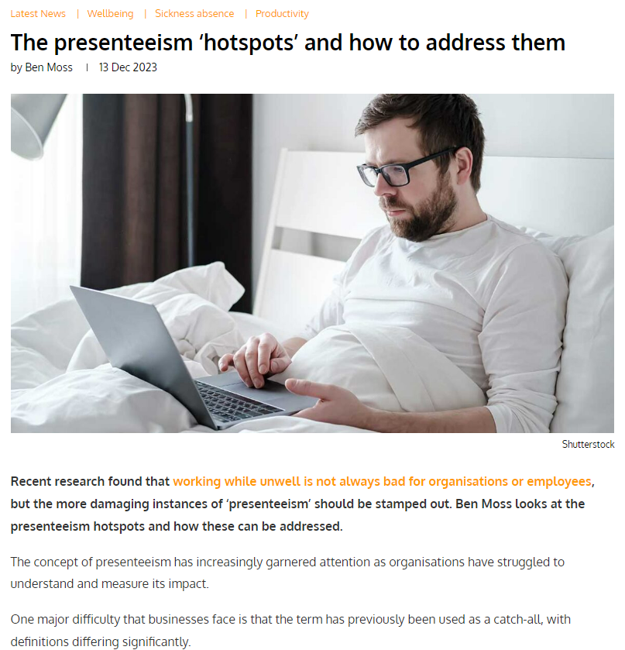
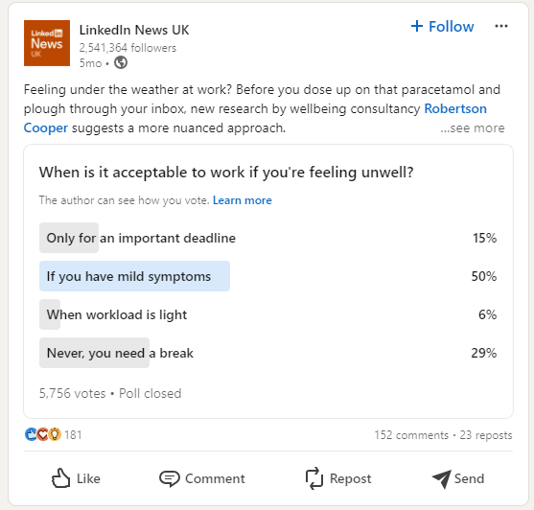
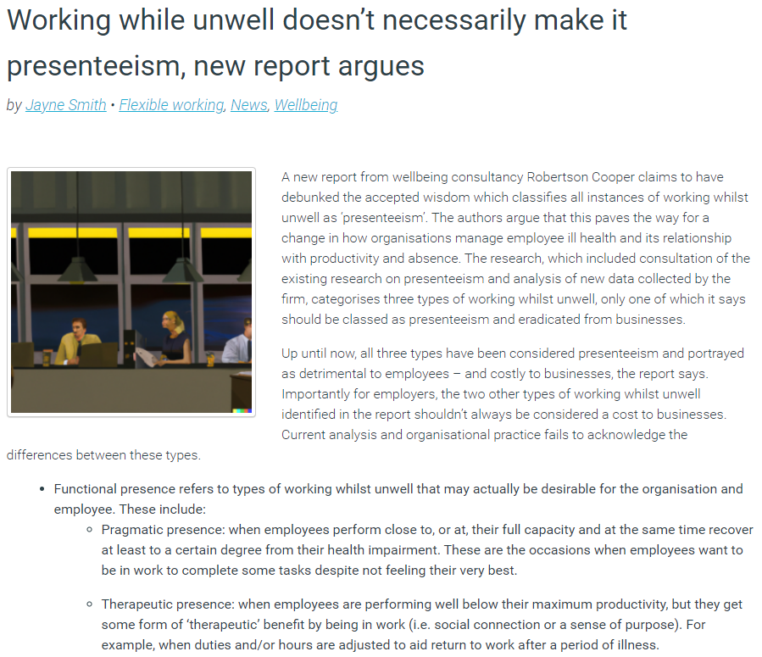
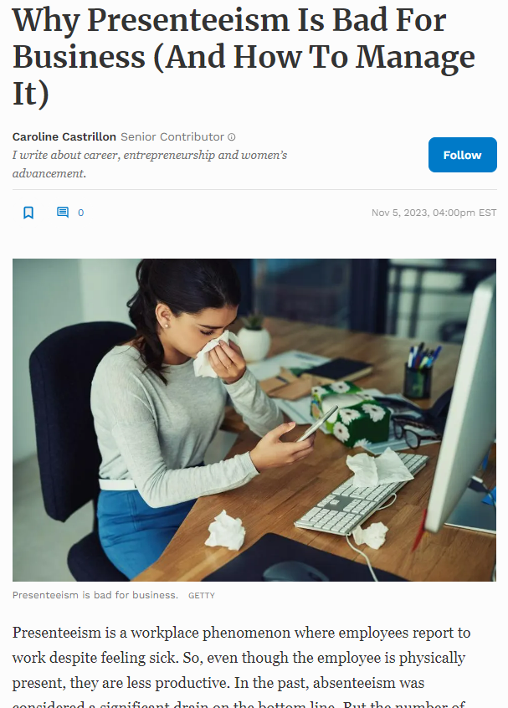
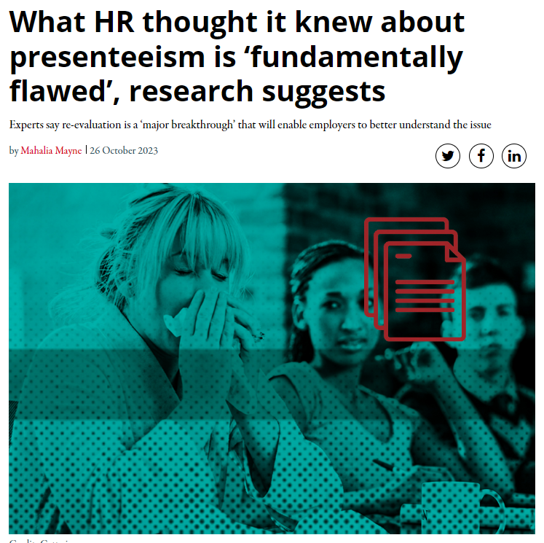
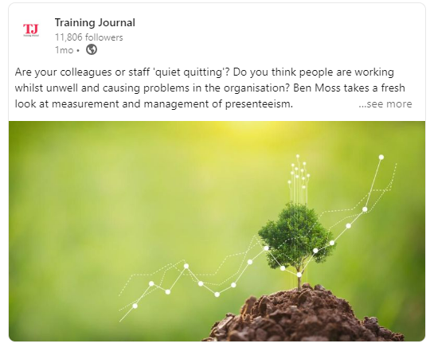
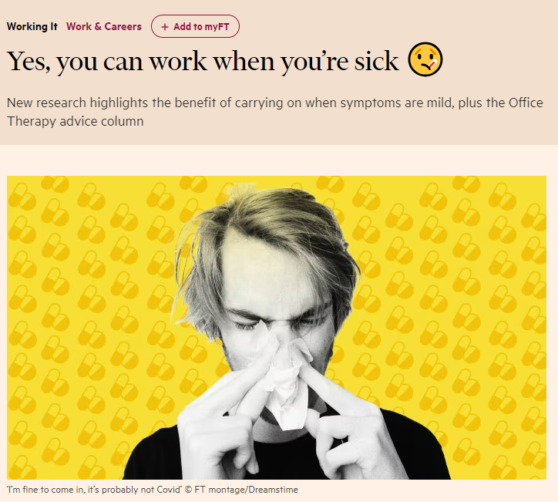
Notes:
Inspired by EDF Group’s interest in the area - we had a session with the exec team on the topic – we conducted research and made a breakthrough
Felt we were onto something, wanted to test this idea with thought leadership and it really caught fire!
The engagement helped us to formulate new approaches to measuring and managing presenteeism which is currently being used by EDF Nuclear Operations and Services

Slide 35
A new understanding of Presenteeism
As a result, the prevalence & cost numbers you think you know for presenteeism are almost certainly wrong
Working whilst unwell can be very bad for productivity, but not always!
Understanding the 3 different types enables management & personalised support
Focus of the conversation shifts to ‘working whilst unwell’: there are 3 types & only one of them is presenteeism
Presenteeism and absence rates are highly correlated – making presenteeism a leading indicator for rising absence
Notes:
Our journey involved revisiting the research on presenteeism, collecting fresh data and analysing the intricate relationships among key presenteeism-related metrics, including productivity and absence.
This process led us to a pivotal realisation: not all instances of working whilst unwell are alike. In fact, there are three distinct types, with some forms likely to be deemed acceptable, even desirable, by many organisations and their employees.
Over the last 9 months we’ve reframed the conversation around presenteeism - introducing the idea of Working Whilst Unwell - identifying 3 types
SHIFT THE CONVERSATION 2 of the types are often acceptable – even desirable – for employers and employees. Until now they’ve ALL been known as Presenteeism
THE NUMBERS ARE WRONG - The implication of this is that the long-accepted numbers around presenteeism are just wrong - they’re too high, but when you measure ‘true presenteeism’ a higher proportion of cases have significant productivity hits
PRODUCTIVITY - As an extension of that line of thinking, whilst productivity is seriously threatened by long-term presenteeism, productivity is not usually significantly less than average during short episodes
THE LINK TO ABSENCE - presenteeism and absence rise and fall together, it’s not one or the other

Slide 36
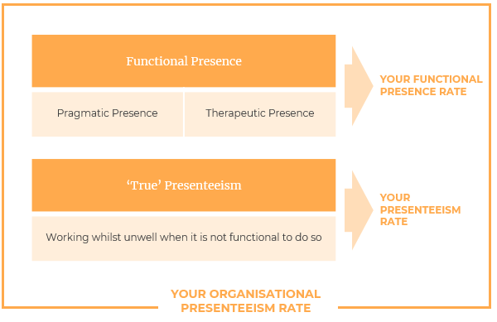
The 3 types of 'Working While Unwell'
Incidence rates of Working Whilst Unwell. Robertson Cooper, 2023.
Notes:
Describe functional vs dysfunctional types. KEY WORD HERE IS ‘FUNCTIONAL’ Two types of ‘presence’ that need managing, but not necessarily discouraging. ‘True’ Presenteeism which is always dysfunctional and should be discouraged
Pragmatic – use e.g. of cold if homeworking and manageable back pain / RSI if in office
Therapeutic - use RTW example, adjusted hours and/or duties
True Presenteeism – no function in it, should always be discouraged
As such ALL 3 are labelled as Presenteeism which needs to be minimised or stamped out – a negative
MEASUREMENT – when you can differentiate between the different types of working whilst unwell and the reasons for that by properly measuring / tracking them, you can start to manage each type effectively
Pragmatic – 8%
Feeling under the weather but working won’t have any long-term impacts on your (or anyone else’s) health. You are still able to work at a similar level to your usual output.
Therapeutic – 12%
When you believe the decision to work will make you feel better; e.g. a mood increase from socialising or feeling useful, or a direct health benefit derived from your work.
Presenteeism – 39%
Any time you work whilst unwell and don’t fall into the above categories. Working has a negative impact on your health/mood and, as a result, your productivity significantly falls.
None – 41%
People who either weren’t unwell or chose not to work when they were.

Slide 37
Measuring productivity impact
Clear read-out of impact on productivity by type of working whilst unwell (WWU)
Ability to relate this to incidence rates and make decisions about where to take action
Creates opportunity to see this alongside absence data for specific areas of the business
Notes:
Productivity loss trends exactly as we predicted - highest for true presenteeism, lowest for pragmatic presence with therapeutic presence in the middle
A different angle on that is that we found 398 total days lost days of productivity in the sample:
55% lost to absence – employee should take sick leave… and does.
39% lost to ‘true presenteeism’
6% lost to functional presence
‘True presenteeism’ isn’t more than absence (as commonly believed) but it’s similar, and still v costly to employers
Employees who work whilst unwell generally are 2.4x more likely to be off sick than those who don’t; BUT employees who engage in ‘true presenteeism’ are 1.6x more likely to be off sick compared with those in ‘pragmatic presence’ category
Working whilst unwell is a predictor of absence, but you can see that most of that is driven by ‘true presenteeism’ - that can drive a focus on changing behaviour, move to a place where only functional types are ‘ok around here’

Slide 38
Why the categories matter
 | Working Whilst Unwell Type | % of typical Productivity | % of typical Quality | Productivity Loss: Days per 100 Employees
Intent | Pragmatic | 83% | 80% | 27
 | Therapeutic | 68% | 66% | 66
 | True Presenteeism | 52% | 58% | 255
Reality | Pragmatic | 83% | 81% | 18
 | Therapeutic | 64% | 67% | 36
 | True Presenteeism | 55% | 59% | 295
Based on data collected Mar 2024, asking employees about their experience in the previous 3 months.
Notes:
‘Intent’ refers to the intent behind the decision to work whilst unwell
‘Reality’ refers to the respondent’s reflection on what actually happened as a result of the decision to work whilst unwell
The results are conclusive – True Presenteeism creates by far the biggest hit on productivity and quality of work compared with the other categories.
The implications are:
It makes no sense to lump all the cases of working whilst unwell under the heading ‘presenteeism’
And yet that is exactly what happens in almost every organisation, everywhere – and therefore the same solutions are applied to all 3 groups
It also means that almost every organsation (and research paper) is likely overestimating the incidence of presenteeism (3-4 x absence is commonly heard) but probably untrue
The reality is more likely to be lower incidence of ‘true presenteeism’, but with more serious health impairments in that group

Slide 39
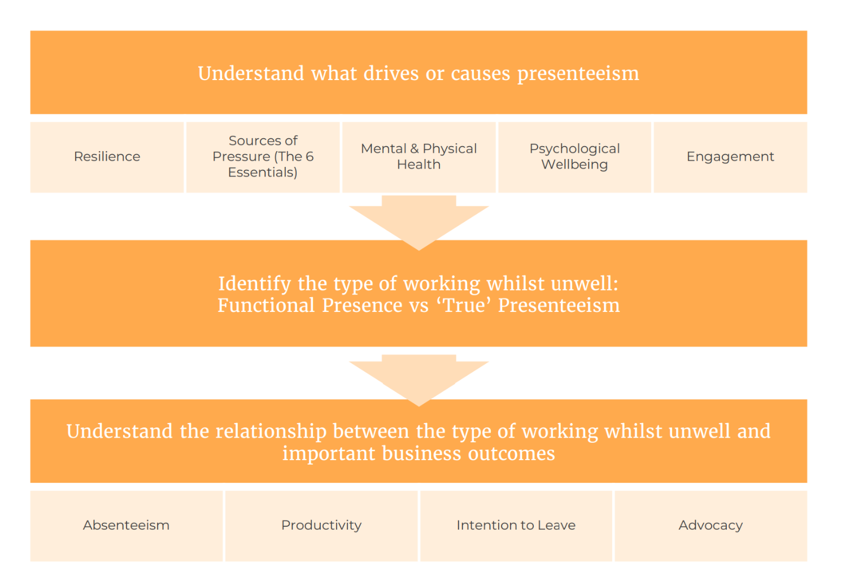
What can you do to manage Working While Unwell?
Workplace Factors:
Policies and processes
Holistic Data-driven view (see left)
Set expectations
Keep pressure positive
Mobilise your managers.
Employee Factors:
Encourage healthy behaviours
Promote good conversations
Empower good decisions.
Notes:
Consider:
Workplace and Cultural Factors:
Policies and processes to drive the right behaviours
Step back and take a holistic data-driven view – the diagram is our model to identify the different types of working whilst unwell and the impact on key business outcomes.
Set expectations – what should employees do in certain scenarios - "intervention mapping" gives employees information on what to do in different scenarios enabling them to make good decisions.
Keep Pressure positive – what preventative measures have you got in place to prevent excessive pressure?
Mobilise your managers – empower managers to have positive, proactive conversations and role model healthy behaviours.
Employee Factors:
Encourage healthy behaviours - employees who exhibit healthy behaviours around exercise, nutrition and sleep are less likely to exhibit presenteeism and absence
Promote wellbeing conversations – personal factors are a big driver of presenteeism, including those who are prone to overcommit to work. Having a manager who can recognise this and have a proactive conversation can be an effective early intervention.
Empower good decisions – an open, proactive culture will empower employees to make a good choice.

Slide 40
Conclusions
 | Taking a holistic data-driven approach to wellbeing ensures wellbeing activities can be targeted, tailored and measured.
 | Understanding health, safety and wellbeing risks and the drivers of poor wellbeing gives organisations insights into the levers they can pull for effective change.
 | Our Presenteeism research demonstrates how meaningful measurement can shed light on previously ambiguous organisational problems.
 | There are clear steps that organisations can take to address cultural and workplace factors that may contribute to Working Whilst Unwell and empower employees to make healthy decisions.
Notes:
A data-driven approach is foundation of a sustainable approach to managing health, safety and wellbeing
Insights need to be more than just interesting; they need to be actionable
The concept of maturity can provide a road map to follow for any organsiations’ health, safety and wellbeing journey
Presenteeism is a core example of where the world has gone with label and ignored what the data is really telling us - it’s a huge area of opportunity for improvement
Hope that’s been useful, can answer questions from the panel - and our friends at EDF will be more than happy to tell you more about the work we’ve been doing with them in this space

Slide 41
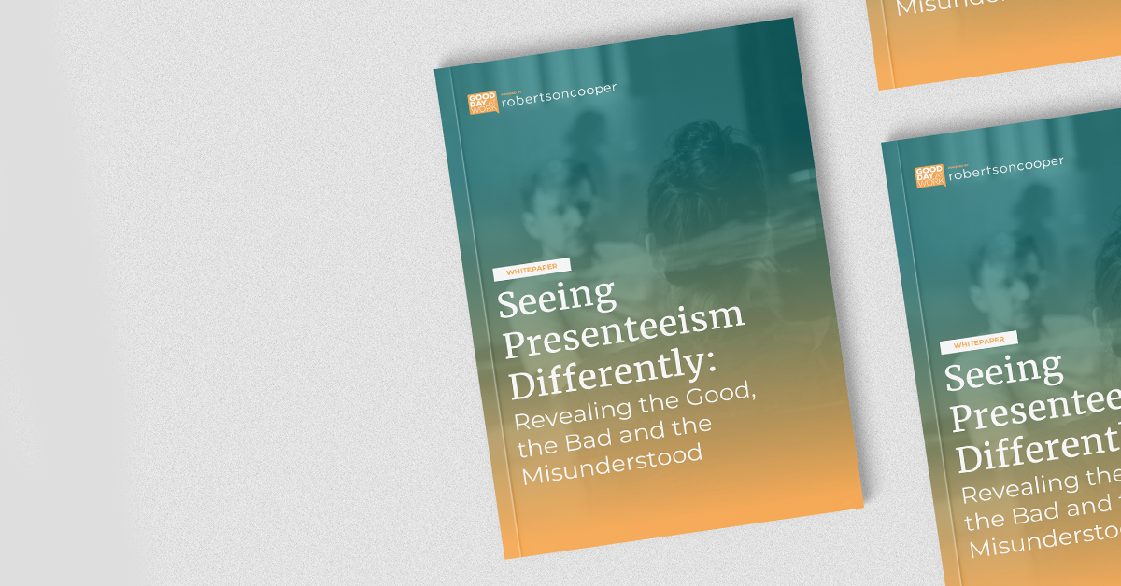
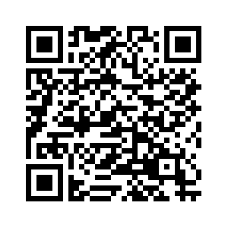
Scan to get your copy
Notes:
This is our presenteeism whitepaper if you’d like to go deeper….

Slide 42
Corporate Risk: The importance of the health factor

Slide 43
Introduction
Health: Why a Corporate Risk Factor?
Failure to address health as a significant factor only increases the likelihood and severity of unacceptable corporate risks.
H&S regulation is primarily to prevent damage to people’s health and prevent loss of life, not because being “safe” is an end in itself.
However, in risk terms, accidents and near misses are given significantly greater prominence than health issues.
HSE’s ALARP infers that the “societal value” of ten people dying in an explosion is higher than ten people dying slowly of cancer.
Notes:
If we look at the fundamentals of Powering Improvement, it specified, among others, the following
“We recognise the serious consequences of work-related accidents and ill health – personal, economic and reputational.
“A safe, healthy and competent workforce is essential to any business.
“We are fully committed to addressing occupational health issues as well as safety ones.
“We are committed to sharing best practice regarding health and safety risk management.”

Slide 44
Hidden in Plain Sight
Health: How are we doing?
The ‘health’ of ‘health & safety’ is almost superfluous for many industries
Health: a paired assumption- health & safety, health & wellbeing
Further still, because health has not been regulators priority, nor Business, health risk becomes an HR process.
Notes:
We talk about Safety and increasingly about health, yet rarely do we just focus on health.
This reflects paired assumptions that if you work “safely,” you will manage health risk; and if you manage “wellbeing,” you will manage mental health.

Slide 45
Hidden in Plain Sight
But, these risks can only increase…
DNO’s are heading towards a perfect storm in relation to health risk. The industry is experiencing a labour shortage and experience gap.
The demands on the mental and physical health is reaching saturation point.
The cost is a diminishing human resource, which is itself critical to the management of all other risks.
Take fatigue, the pressure to keep the lights on leads companies struggling to meet the 16hr maximum working limit, let alone 12hr working
Notes:
DNO’s are heading towards a perfect storm in relation to health risk. The industry is experiencing a labour shortage and experience gap at the same time everybody else is.
The buffer for this has been the demands on the mental and physical health of the workforce. The cost is a diminishing human resource, which is itself critical to the management of all other risks in the member organisations.

Slide 46
The People Risk
Nobody goes to work with the intention of making themselves or others ill. It just happens as a result of neglect and de-prioritisation.
Take HAVS, decades of exposure, a slow accident to harming the workforce
Has not been Regulator’s priority (until now)
Businesses process cases through employment law and HR referral to OH
An accident can trigger the regulatory risk, get the Boards attention. Ill health? Not so much.
Notes:
, An accident is likely to trigger the regulatory risk, whereas a health risk is put into a process through employment law and HR to occupational health referral and out of the waste pipe of staff turnover. An accident can make news, whereas an epidemic of mental health issues is hidden behind a veil of confidentiality and societal stigma.
nor businesses, nor the worker’s, as buried health as risk factor deep within business HR strategies.

Slide 47
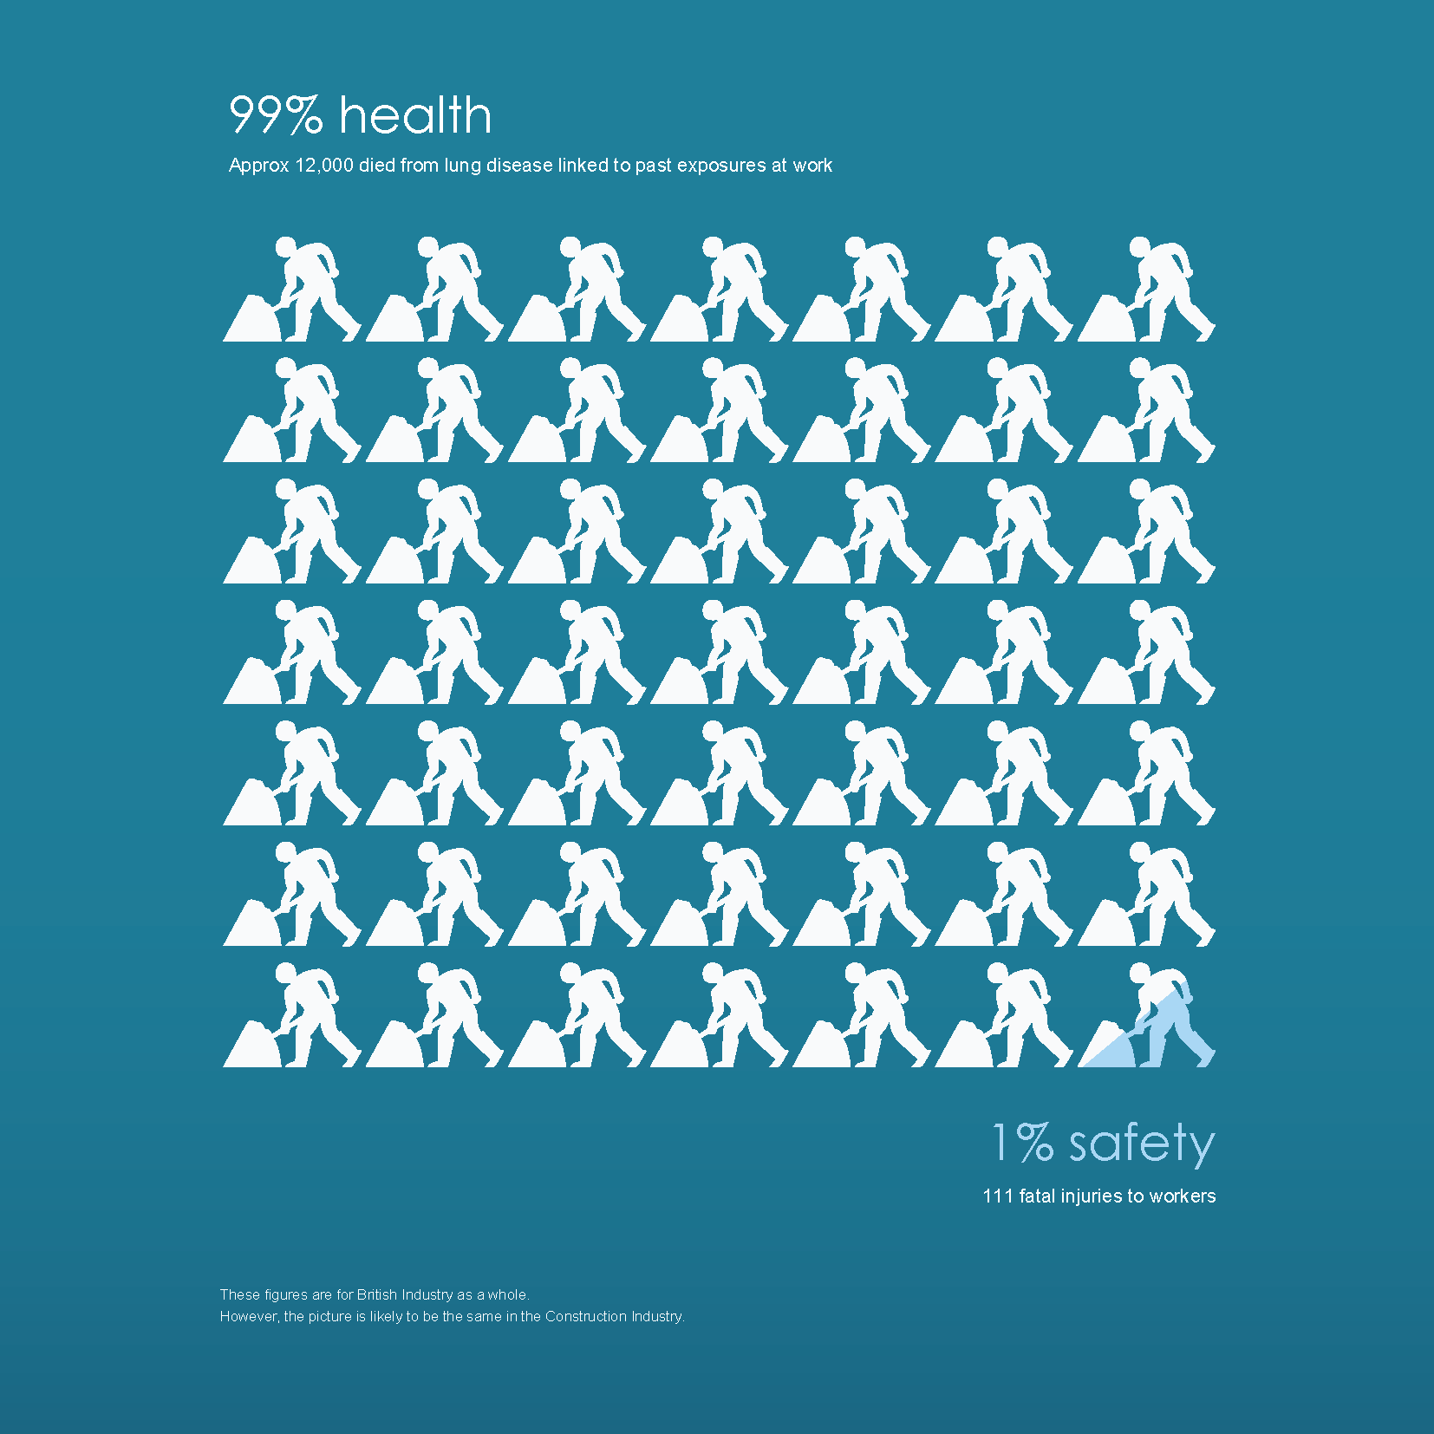
The People Risk
How many organisations, Utilities or others, put the health of their workforce above their financial health and include as a specific corporate risk?
Attributable deaths from health exposures at work each year averages around 13,000 and rising, not including those made unwell.
145 deaths as a result of workplace accidents per year.
Notes:
The simple fact, that has not changed for decades is that the attributable deaths from health exposures at work each year averages around 13,000 and rising, not including those made unwell.
In the last decade, as far as we know for certain, workplace health exposures have been responsible for over 120,000 deaths and 15m people becoming unwell.

Slide 48
The People Risk
Fact: When people can’t work, they turn to the State for social security and the national health for care.
This increases burden on the health service, delays mean longer absences from work
The cost of work-induced COPD alone to the country in healthcare and benefits equates to around a percentage additional cost on national insurance.
Notes:
When people can’t work, they turn to the State for social security and the national health for care. The cost of work-induced COPD alone to the country in healthcare and benefits equates to around a percentage additional cost on national insurance. In a nation where health and social care costs are the number one economic challenge, the workplace as a cause of ill-health which can be taxed to pay for the cost it creates is an inevitable target
Direct factors such as heavy workloads are underpinned by more sinister factors, such as MSDs. Long arduous periods of work have a direct mental impact. However, a vicious circle of pain, lack of sleep, fatigue, self-medication (often with alcohol) contributes further to anxiety, stress, depression, ill-health absenteeism and the impact is them exacerbated on colleagues.

Slide 49
The People Risk
Lack of sleep
self medication
Anxiety/ stress
Ill health/ absenteeism
Pain- MSD
Mental health is a significant cause of absence and unhappiness at work. Yet the causes are nothing new.
Pressures from the big ticket items such as limited resource, complex/ monotonous work, conflict, play a more overt role now

Slide 50
The Cost
Fact: HSE enforcement on health risks likely to remain low, even with increased focus on failure to manage it, lack of resource!
2nd fact: private claims/ lawsuits are on the rise, asbestos claims well known, however NIHL, HAVS are not going away either. Reputational damage?
NIHL/ HAVS range from £30-70K upwards
MSD claims range from £40-160K as standard.
Demonstration of compliance is no longer deemed sufficient to demonstrate provision of best practice provision.
Notes:
The national figures suggest that health impacts run at about 30 times those of RIDDOR reportable accidents. A review of the published data of ENA members indicated that for some incidences of workplace health-related exposures increased by 300-400% between 2021 and 2022.
The rapidity of increase, set against the number of staff would already be an indicator of corporate risk, but also the opportunity to establish liability. At some point, it will become viable for industrial injury lawyers to start looking at areas of poor health in the Networks Industry and starts systematic legal claims.

Slide 51
What next?
Health risks to be made a Corporate priority
Health risks must be identified and managed as a specific and separate risk from safety
Accept the importance for preventing workplace ill health through design, improved IIT and commitment.
An example to consider: Cable handling
HR & Individual cases…

